Slide 1

KATHMANDU UNIVERSITY Department of Civil Engineering Dhulikhel, Kavre
Final Presentation on
Rehabilitation, Upgradation and Maintenance (RUM):
Sunkoshi Small Hydropower(Approach Canal and Settling Basin)
GROUP MEMBERS:
Group No: 9 SUPERVISOR:
Bikesh Mainali(22) Santosh Chaudhary
Sarita Sapkota(44) Assistant Professor
Sagun Singh(51) Department of Civil Engineering
Vijay Raj Waiba(57) Kathmandu University
Ranjit Kumar Yadav(60)
Bibek KC(64)

Slide 2
OVERVIEW OF PRESENTATION
Introduction
Objectives , Need of the Project
Limitations of the Project
Salient Features of hydropower
Methodology
Catchment area
Topographic Map Survey Area
Longitudinal Section
Cross Section of Canal
Hydrological Analysis
RUM in Approach Canal and Settling Basin
Design of Approach Canal and Settling Basin
Work Schedule
Conclusion
References
Annex

Slide 3
Introduction to RUM
Building a new hydropower plant requires a significant investment, a lengthy legal process, and years of building and output.
Instead, repairing, upgrading, and maintenance an existing hydropower plant is incredibly inexpensive, ecologically friendly, and fulfills sustainability standards.
Additionally, it takes less time to perform. As a reason, RUM for existing hydropower is critical.
Rehabilitation studies cover the key components and facilities of the HPP, as well as proposals for improving it.
Upgrading involves improving design performance, whereas Maintenance means preserving the components of the hydropower by regular inspection and replacing if necessary.
As a consequence of this attempt, it will be possible to increase installed capacity, extending the power plant's life and making it more sustainable
We can also achieve consistent and dependable energy output with minimal investment.

Slide 4
Rehabilitation:
Rehabilitation involves restoring damaged hydroelectric plant components, such as reservoirs, canals, intake structures, and turbines.
Upgradation:
Process of raising anything to a higher level, especially by adding or eliminating parts
Among the upgrades are:
Increasing the capacity of generators;
Increasing the efficiency of turbines.
Increasing head,
Increasing discharge

Slide 5
Maintenance
Preventive Maintenance: Regular maintenance in hydropower plants is essential for preventing downtime and minimizing operational disruptions, involving inspections, lubrication, cleaning, and calibration of equipment to identify potential issues.
Corrective Maintenance: In addition to preventive measures, hydropower facilities require prompt attention to repair unexpected breakdowns or malfunctions. Corrective maintenance involves quickly diagnosing problems and implementing solutions to restore operations with minimal downtime.
Scope of RUM
Increased Efficiency: Enhancing technology and infrastructure to improve power generation efficiency and output.
Extended Lifespan: Prolonging the operational life of the plant through regular maintenance and upgrades.
Enhanced Safety: Implementing advanced safety measures and ensuring reliable operation through consistent upkeep.
Sustainable Operation: Adapting to environmental changes and reducing the ecological footprint of the hydropower plant.

Slide 6
Objectives and Need of the RUM
Objectives:
To recognize the issues and categorize them
To redesign the Sunkoshi HPP
To increase the Sunkoshi HPP's installed capacity
To update the Sunkoshi HPP
Needs:
Replace or refurbish old components to ensure efficient and safe operation.
Upgrade technology to enhance power output and reduce energy losses.
Regular maintenance to prevent failures and ensure the safety of infrastructure.
Implement measures to manage impacts of climate change and maintain sustainable power generation.

Slide 7
Limitations
High Costs: Rehabilitation and upgradation can be expensive, requiring significant financial investment.
Operational Downtime: Maintenance activities may necessitate shutting down the plant, leading to temporary loss of power generation.
Technical Challenges: Upgrading old systems to integrate with modern technology can be complex and technically demanding.
Environmental Impact: Construction and rehabilitation activities might disrupt local ecosystems and affect the surrounding environment.

Slide 8
Salient Features of Hydropower
The construction of SSHP was started in 2003 and completed in 2005
Sunkoshi hydropower (2.5 MW) was constructed by Sanima hydropower pvt Ltd.
Simple run of river hydropower project with installed capacity of 2.5 MW
Only project in Nepal to utilize pressurized glass fiber reinforced plastic (GRP) pipe for flow condition.
• Location:
90 km north east of Kathmandu along Araniko highway in the Dhuskun of Sindhupalchowk district. About 3 hrs. of ride from Kathmandu University.
Coordinates: 27°46’55”N 85°55’10”E
SSHP also touches Chokti and Karthali VDCs, due to afflux extending to the boundaries of these two VDCS, and Barhabise VDC, since the access road to the project site passes through it.

Slide 9
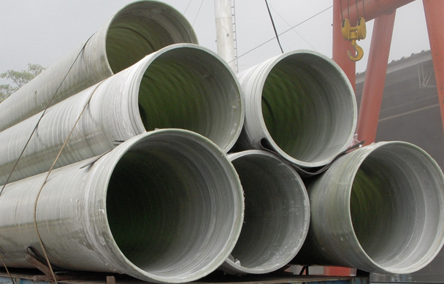
Pressurized glass fiber reinforced plastic (GRP) pipe:
Made from glass fibers embedded in a resin matrix, designed to handle high pressures and resist corrosion.
Widely used in hydropower projects due to their superior properties.
Used in this Hydropower due to:
Lightweight and easy to transport/install.
Long lifespan with reduced maintenance costs.
Smooth internal surface reduces friction losses.
Resistant to high internal pressures and abrasion.
Customizable sizes and configurations.
Lightweight, easy to cut/join, reduced labor costs.
Corrosion resistance and durability lower maintenance needs.
Higher initial cost but long-term savings.
Fig: GRP Pipe

Slide 10
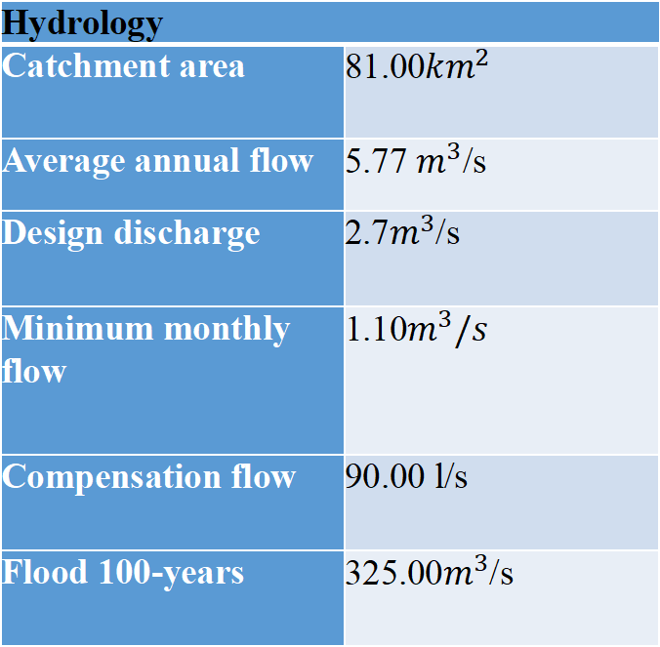
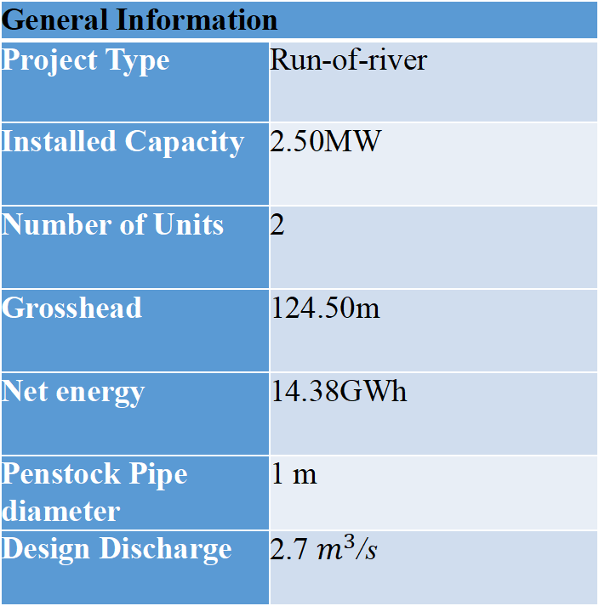
General Information
Project Type | Run-of-river
Installed Capacity | 2.50MW
Number of Units | 2
Grosshead | 124.50m
Net energy | 14.38GWh
Penstock Pipe diameter | 1 m
Design Discharge | 2.7 $m^{3}$/s
Hydrology
Catchment area | 81.00${km}^{2}$
Average annual flow | 5.77 $m^{3}$/s
Design discharge | 2.7$m^{3}$/s
Minimum monthly flow | 1.10$m^{3}/s$
Compensation flow | 90.00 l/s
Flood 100-years | 325.00$m^{3}$/s

Slide 11
Approachcanal
Length | 220.00m
Size | 1.60x1.50m
Settling basin
Length (Including transition) | 77.00m
Settling length | 45.00m
Particle size to be settled | 0.2 mm
Particle trapping efficiency | 90%
Settlingbasin
Length(Including transition) | 77.00m
Settling length | 45.00m
Particle size to be settled | 0.2 mm
Particle trapping efficiency | 90%

Slide 12
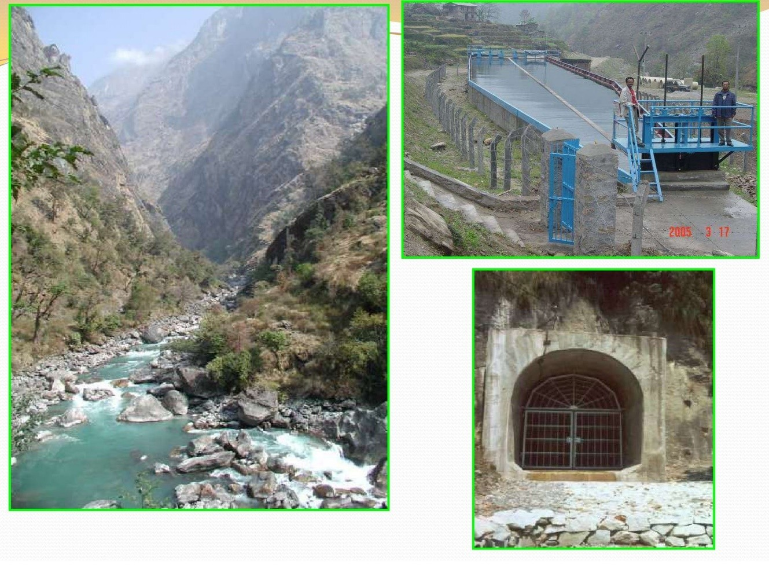
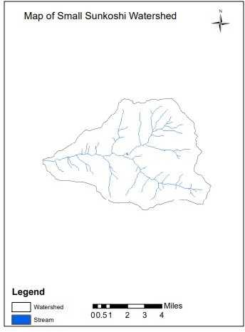
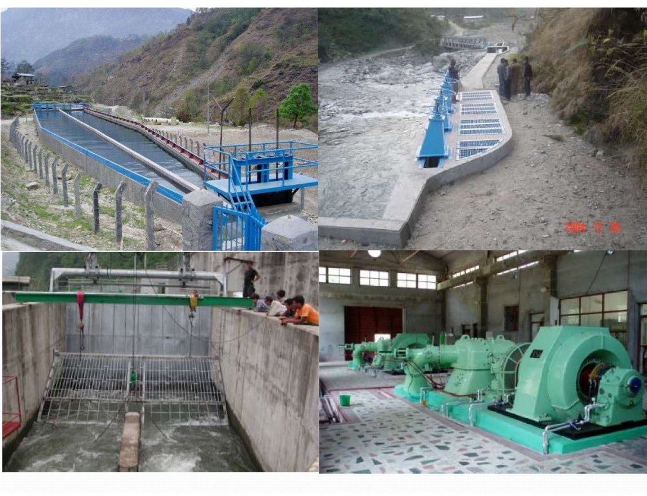
Fig: Sunkoshi small hydropower plant

Slide 13
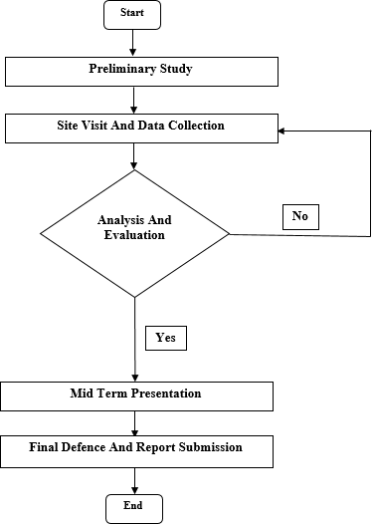
Methodology

Slide 14
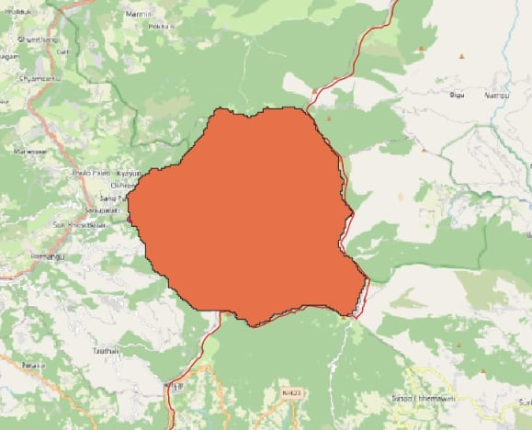
Catchment area of Sunkoshi River
Area covered by catchment:
Bhotekoshi
Barhabise
Tripurasundari
Balefi
Lisangkhu
Sunkoshi
Catchment Area :84.176 km2
Calculated from QGIS

Slide 15
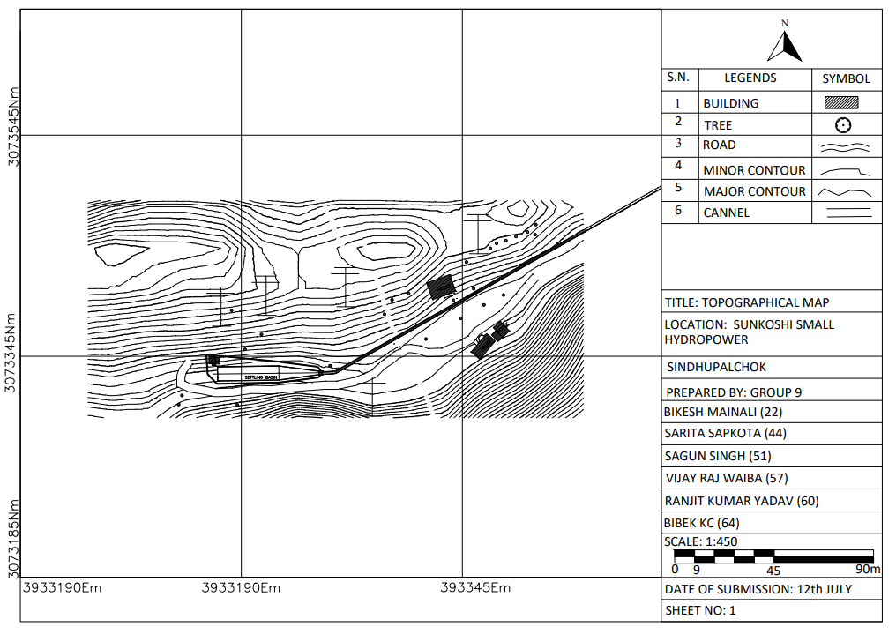
Topographic map of survey Area
Fig: Topo map of project area

Slide 16
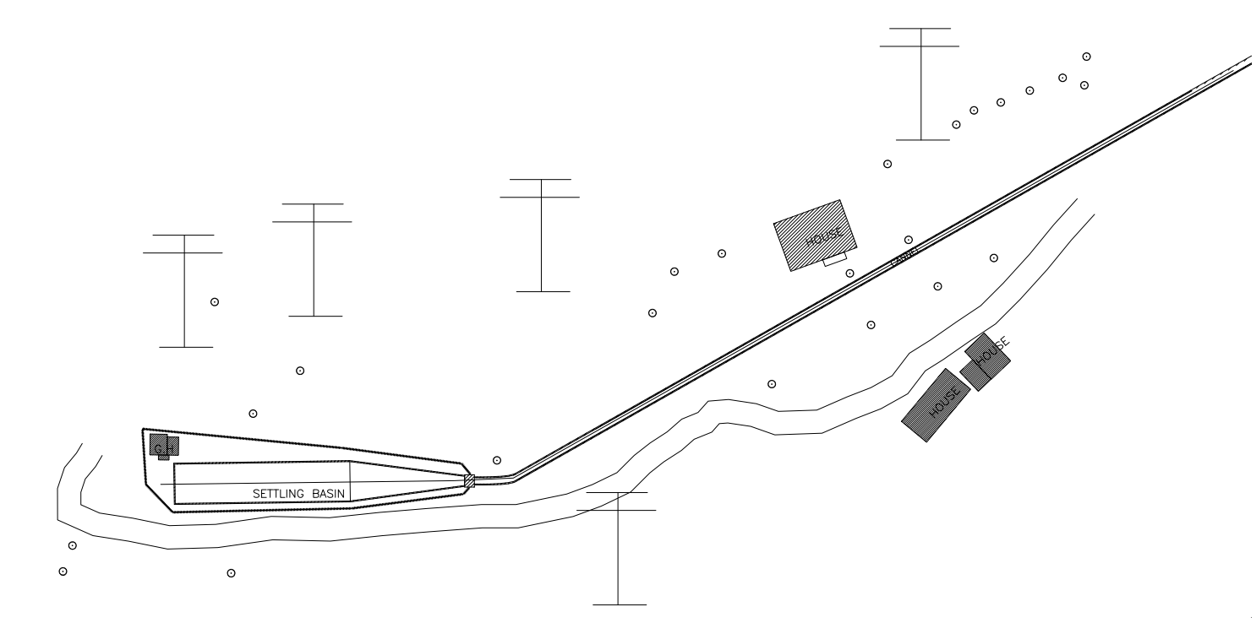
Topographic map of Approach Canal and Settling Basin
Fig: Topo map of approach canal and settling basin

Slide 17
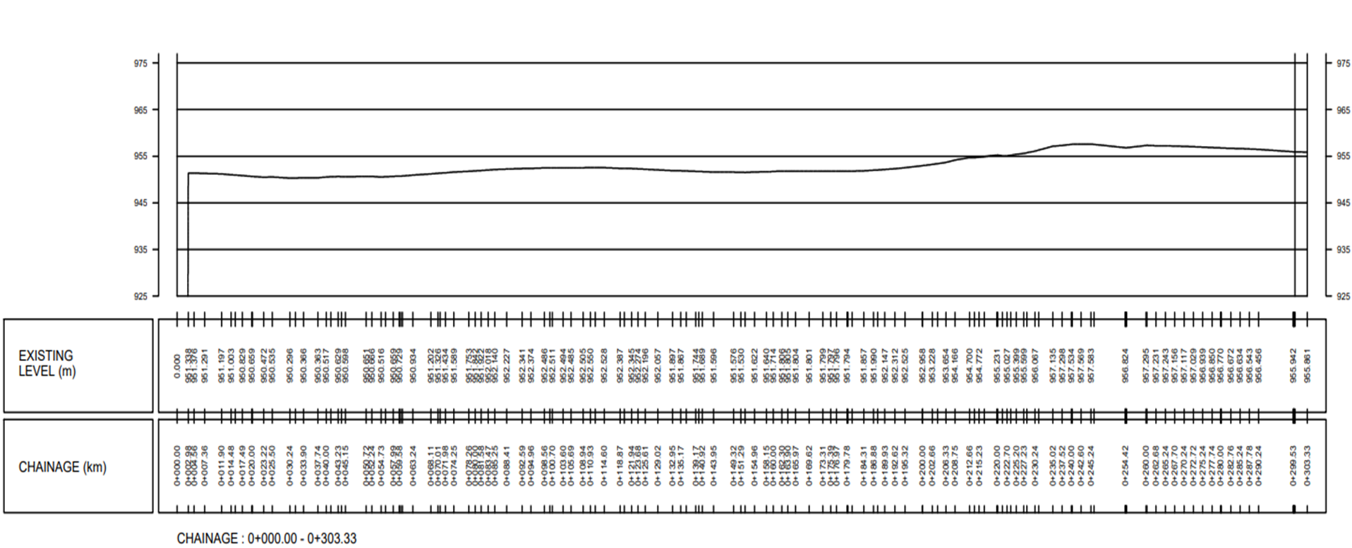
Longitudinal Section
Fig:L-section along the centre line alignment of canal

Slide 18
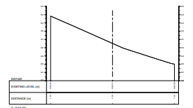
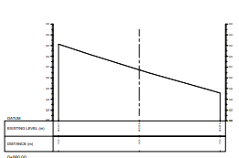
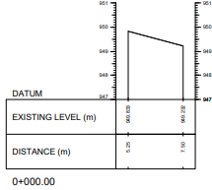
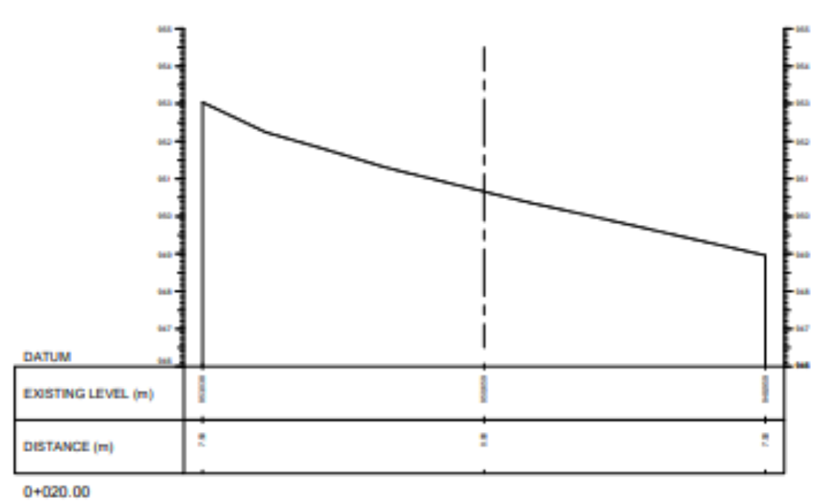
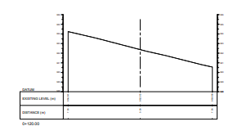
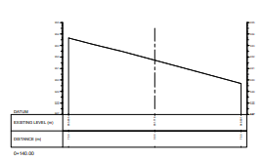
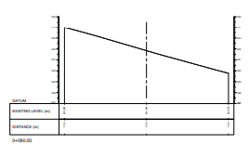
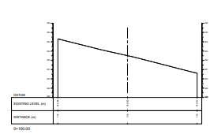
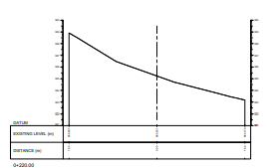
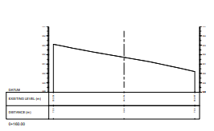
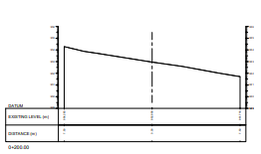
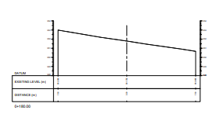
Cross Section of canal
At 0+040.00 chainage
At 0+060.00 chainage
At 0+020.00 chainage
At 0+000.00 chainage
At 0+140.00 chainage
At 0+120.00 chainage
At 0+080.00 chainage
At 0+100.00 chainage
At 0+160.00 chainage
At 0+180.00 chainage
At 0+200.00 chainage
At 0+220.00 chainage

Slide 19
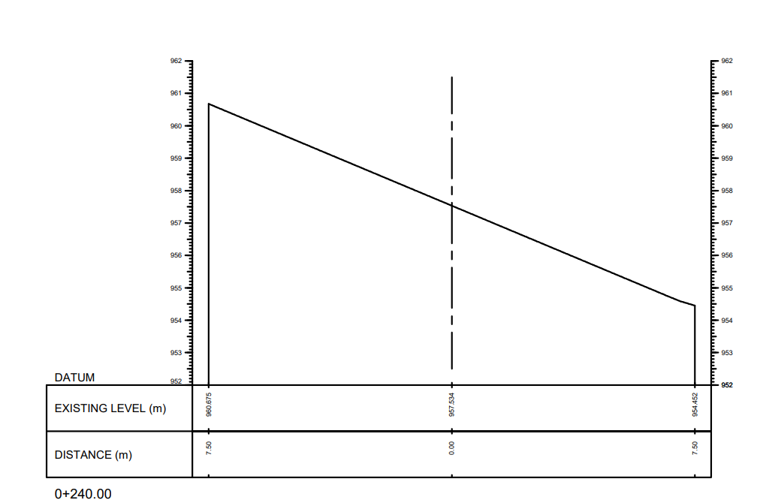
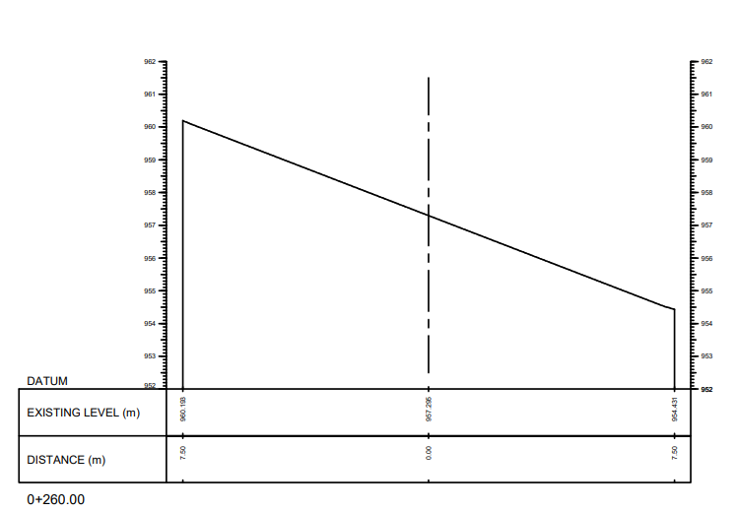
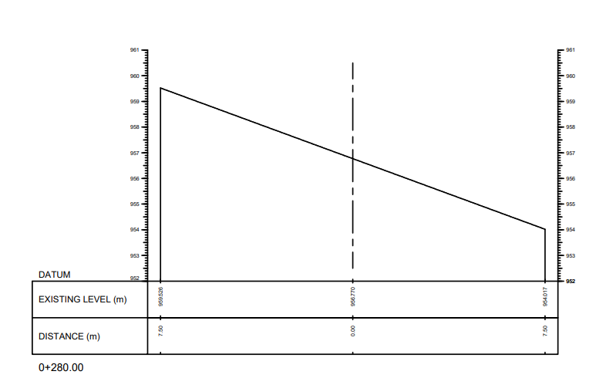
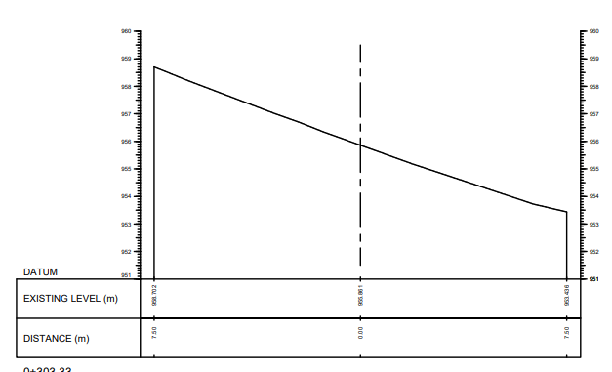
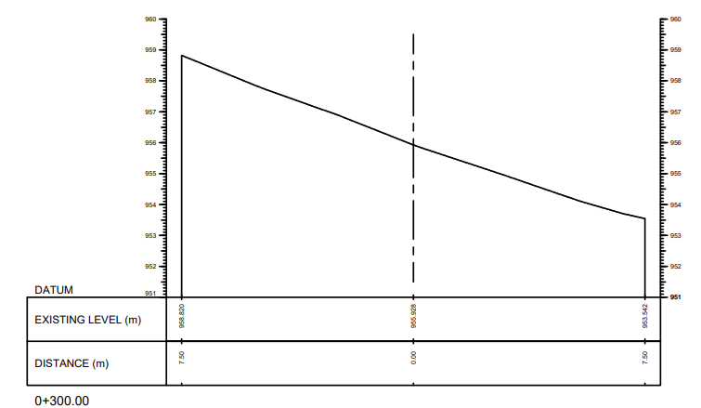
At 0+240.00 chainage
At 0+260.00 chainage
At 0+280.00 chainage
At 0+300.00 chainage
At 0+303.33 chainage

Slide 20
Hydrological Analysis
A. Calculation of Monthly Discharge
Catchment Area Ratio (CAR)
Fig: Hydrograph

Slide 21
B. Flow Duration Curve
Discharge at Q40= 3.602 m3/s

Slide 22
C. Calculation of power and energy

Slide 23
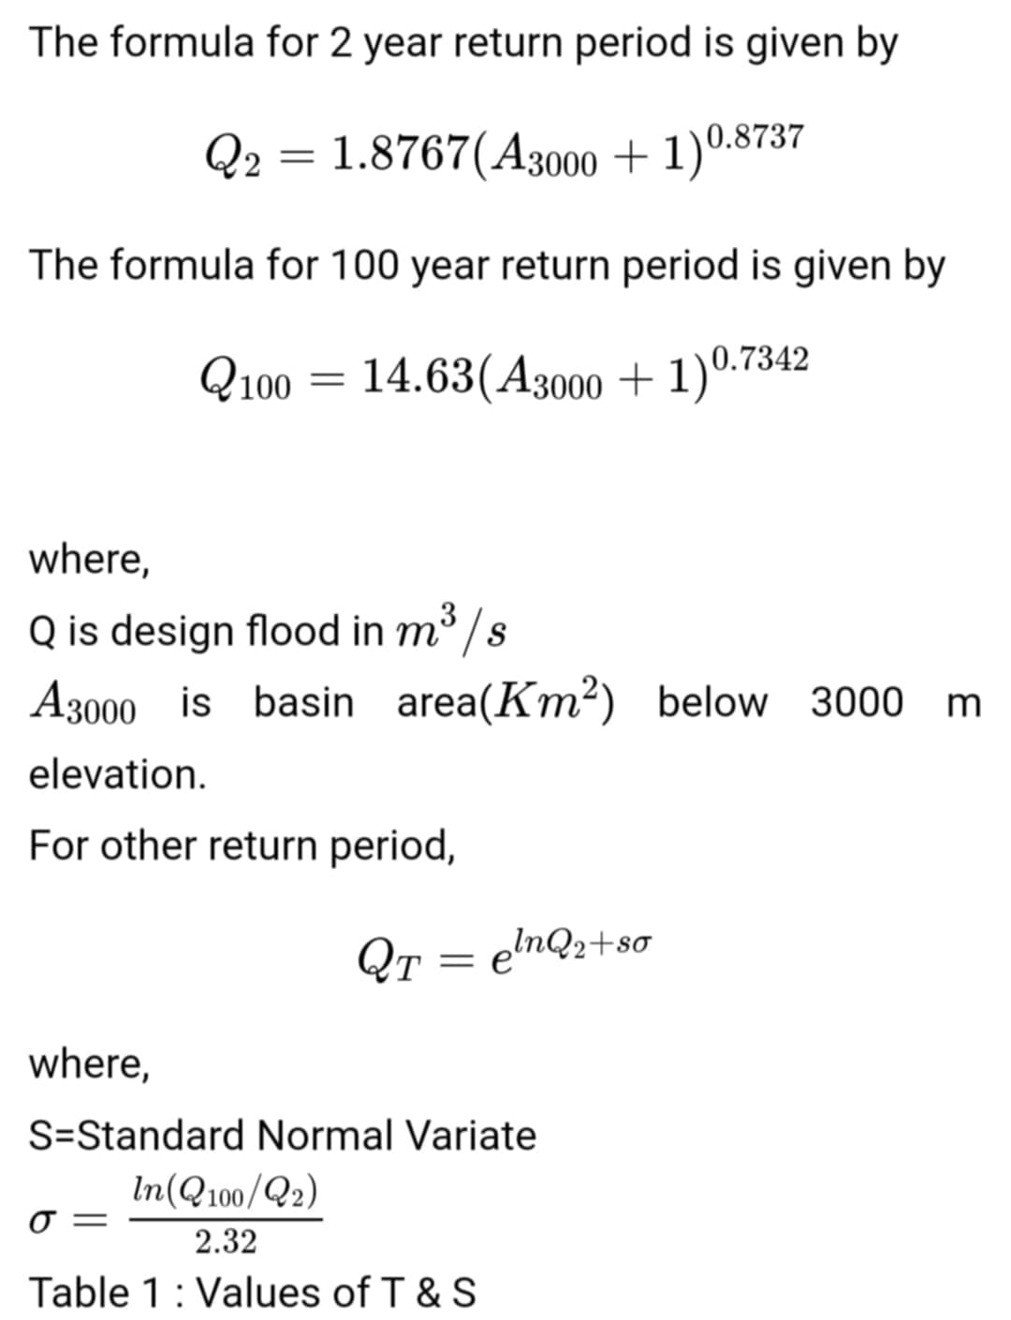
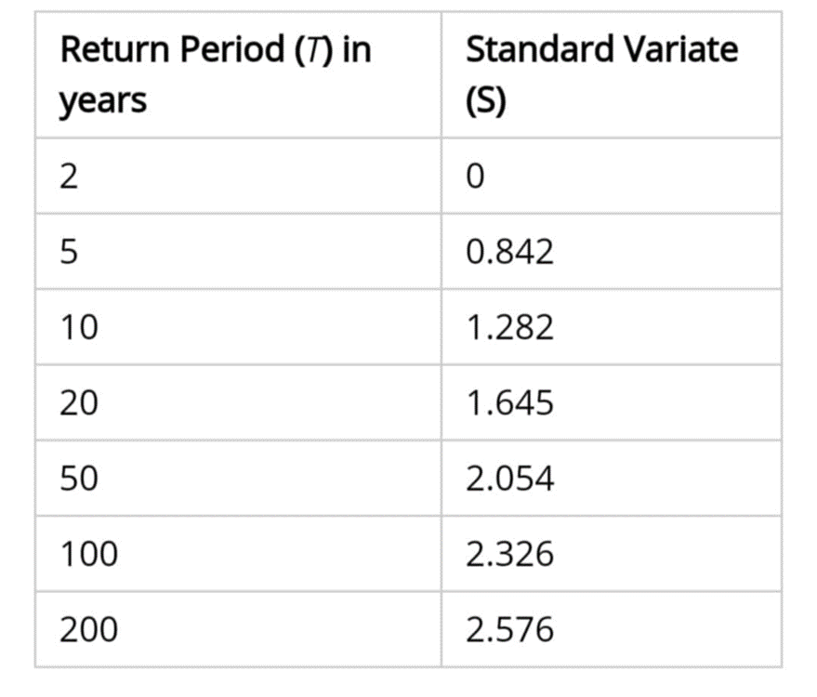
Design Flood Analysis
Return period(Yr) | Discharge(m3/s)
 | MHSP 1997 | WECS/DHM 1990
5 | 234.28 | 5.12
20 | 358.77 | 10.38
50 | 450.94 | 14.87
100 | 527.68 | 18.89
1000 | 853.17 | 37.01
Formulas Used for WECS 1990:

Slide 24
RUM in Approach Canal and Settling Basin
Rehabilitation
Structural Repairs:
Reinforcement of canal walls
Repair of basin walls and floor
Strengthening of critical areas in Basin and approach Canal
Sediment Removal
Cleaning and dredging
Preventing blockages in Canal
Optimization of sediment management through Flushing Culvert
Upgradation
For the upgradation of hydropower project, we have increased the dimension of Canal and Basin.

Slide 25
Maintenance of Approach Canal
Regular Inspections
Scheduled checks for damage and wear
Immediate repairs to prevent issues
Preventive Measures
Installation of debris screens
Routine cleaning schedules
Maintenance of Settling Basin
Regular Cleaning
Scheduled dredging
Removal of accumulated sediments
Monitoring Systems
Continuous performance tracking
Predictive maintenance based on data

Slide 26
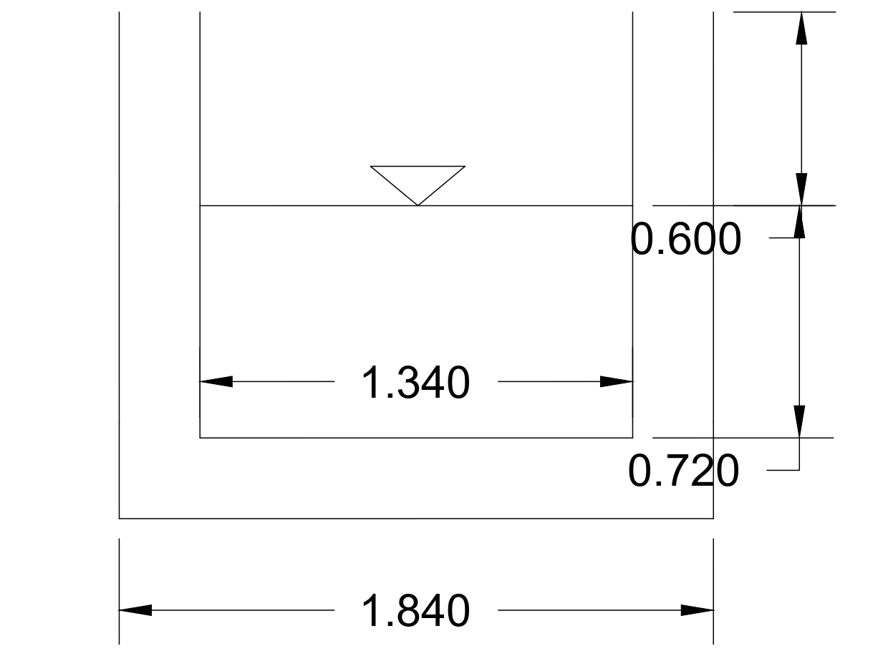
Design of Approach Canal
Fig: Drawing of Apporach Canal

Slide 27
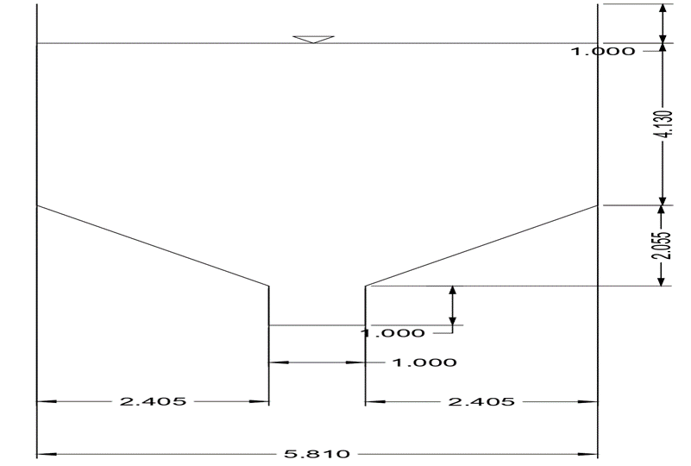
Design of Settling Basin
Fig: Cross section of settling basin

Slide 28
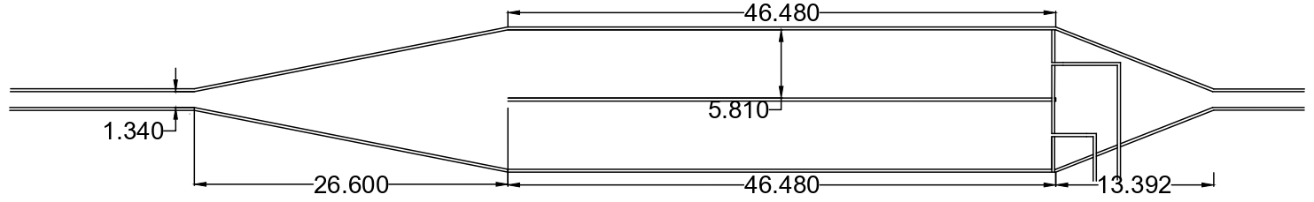
Fig: Plan of Settling basin

Slide 29
Work Schedule

Slide 30
Conclusion
RUM project successfully enhanced the efficiency of the Sunkoshi Small Hydropower plant, leading to higher electricity output.
Sediment Problem in the Settling Basin was solved.
Rehabilitation efforts extended the operational lifespan of the facility, ensuring long-term sustainability.
Upgrades reduced downtime and improved the reliability of the power supply.
Maintenance activities minimized future repair costs and optimized operational expenses.
Implementing modern, eco-friendly technologies reduced the environmental impact of the hydropower plant.

Slide 31
Reference
•https://sanimahydro.com.np/sanimahydro/?url=project&id=20
•http://www.nepalenergyforum.com/sunkoshi-small-hydropower
•https://www.researchgate.net/publication/337825289_Pre-feasibility_study_of_Sunkoshi_run-off_river_hydropower_project
http://www.nepalenergyforum.com/sunkoshi-small-hydropower-plant/
Baral, Sanjeeb (2016). Fundamentals of Hydropower Engineering Kathmandu: National Book Center Pvt. Ltd.

Slide 32
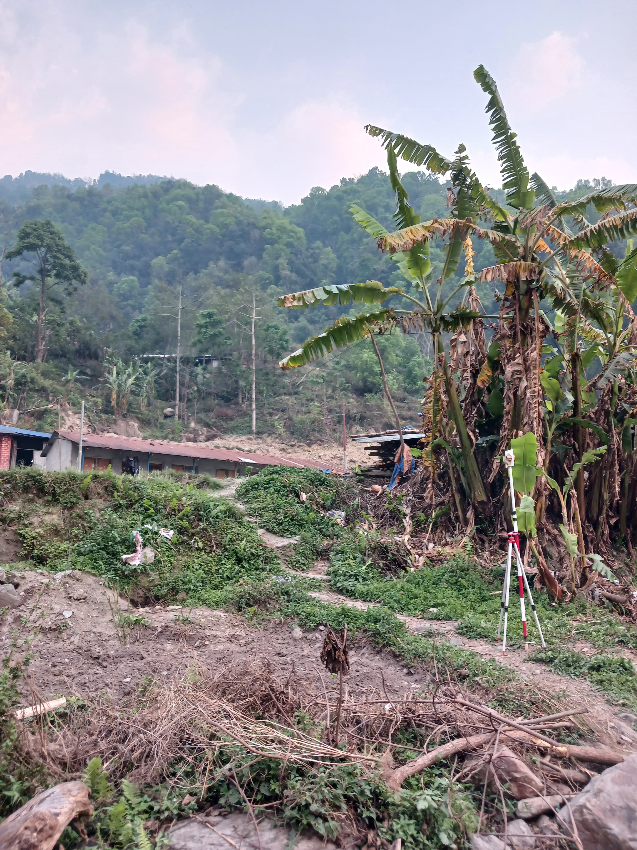
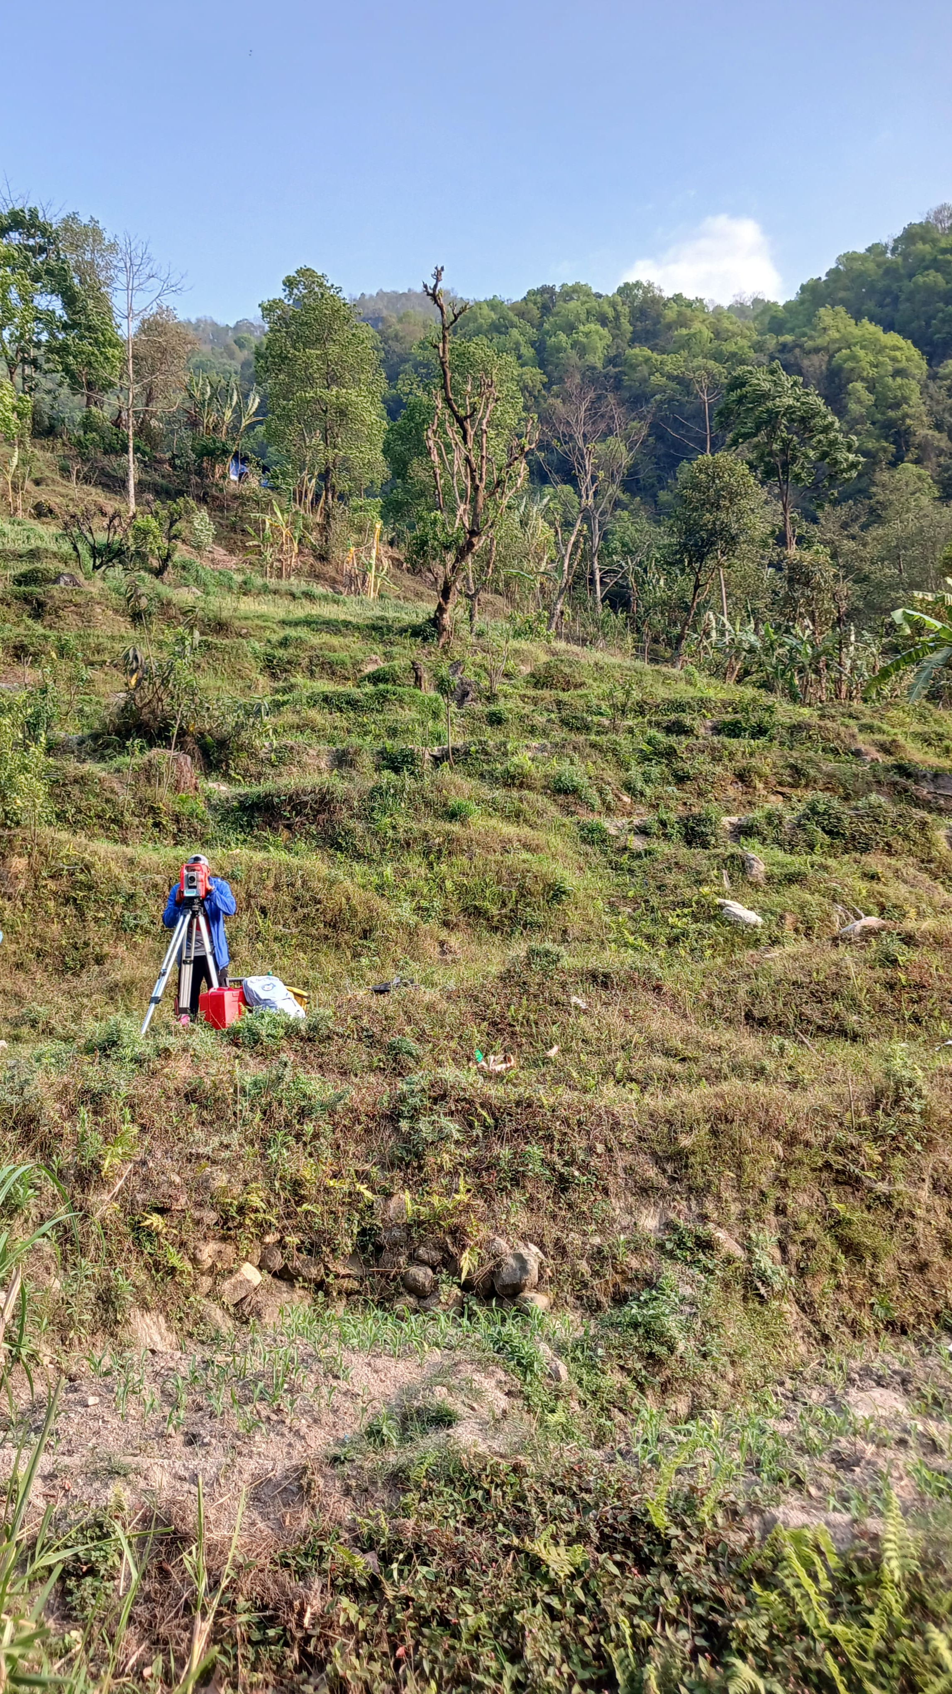
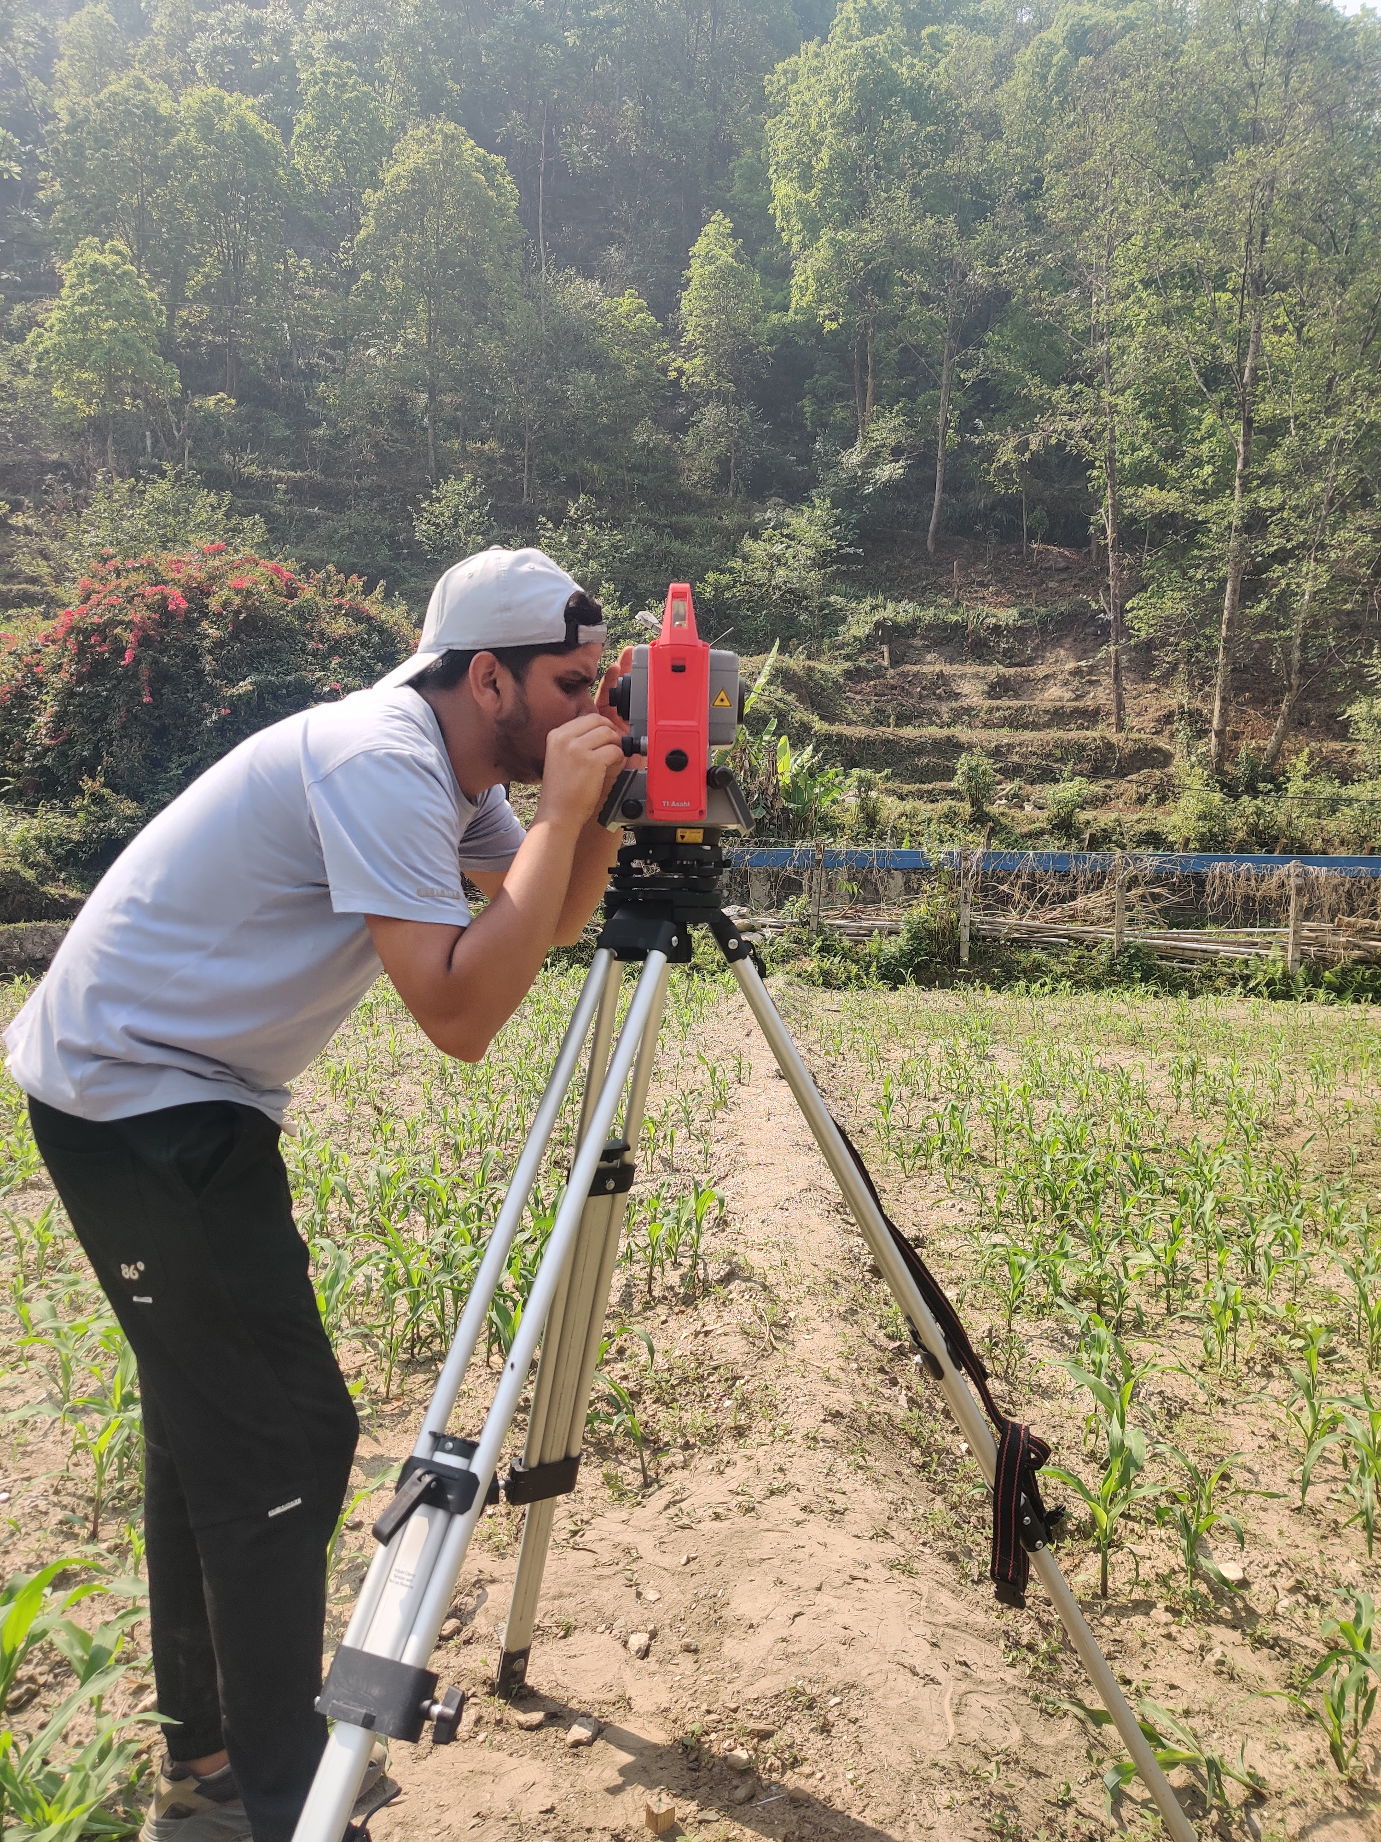
Annex
`Photo: Detailing

Slide 33
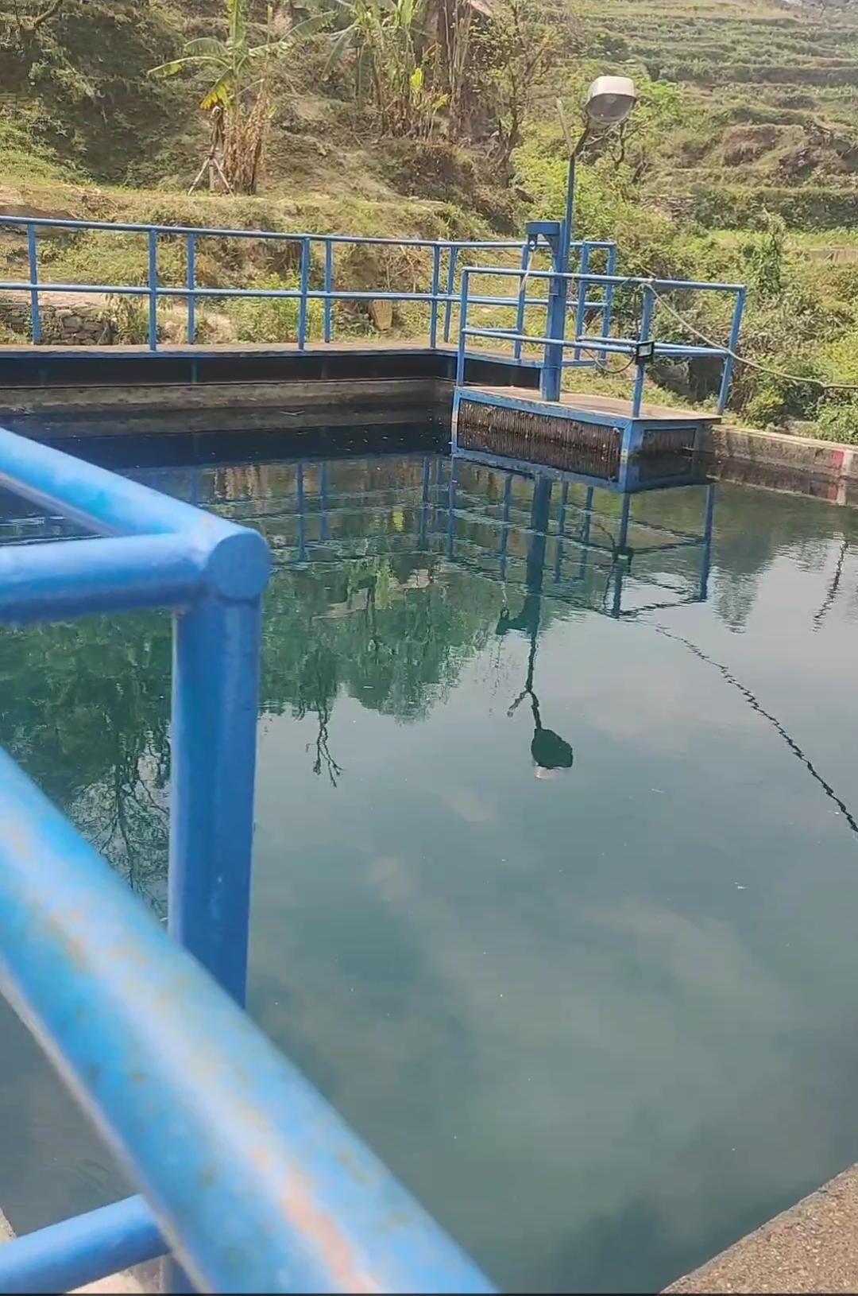
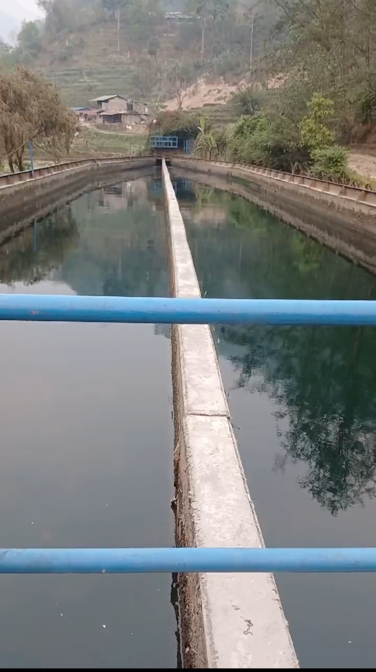
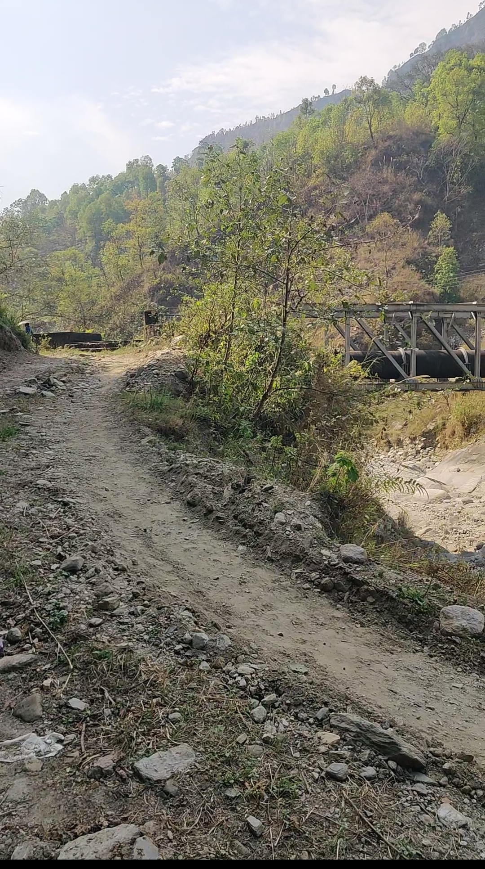
Photo: Settling Basin
Photo: Approach Canal

Slide 34
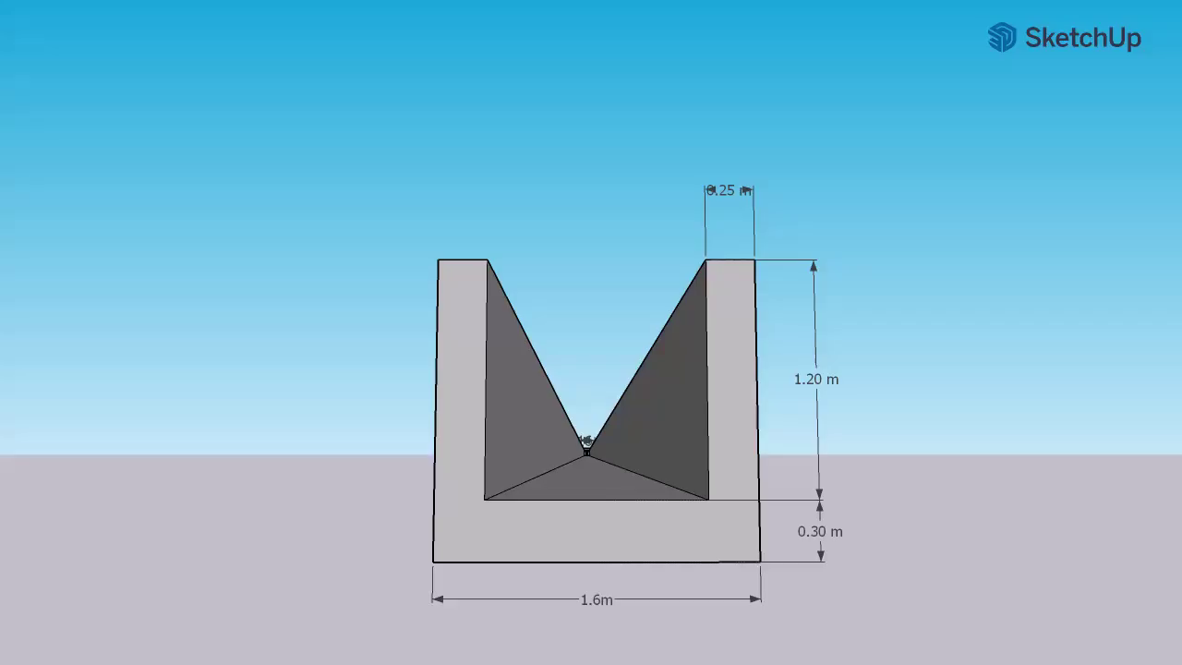
Sketch Up Drawing(Existing)

Slide 35
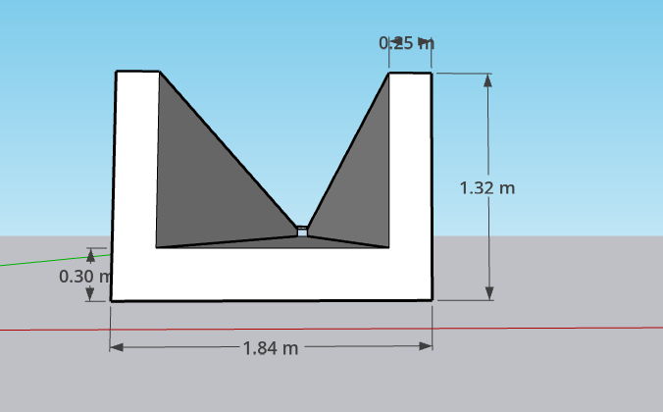
Sketch Up Drawing (Proposed)

Slide 36


